Slide 1
Bridge
Infrared Thermography
Develop in civil infrastructure inspection
Road
Build
Service
Meet customers’ requirements
more

Slide 2
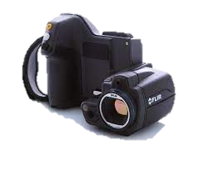
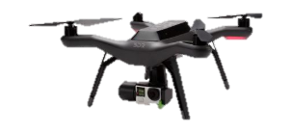


Scenarios
Scenarios
Bridge
Pavement
Buildings
Data collecting
Data
IR camera
Drone
Data process
Technology
Computer vision
Code Programing
ROI cropping
Preprocess
Python
Java
Segmentation
Postprocess
C++
…
Customer
Product
Software
App

